Slide 1

Data-Driven Strategies for Enhancing Spotify Popularity and Stakeholder ROI: A Machine Learning Approach
Research Question:
How do artists optimise track attributes and genres to predict and enhance Spotify track popularity?
Student: Chao Yuan Hsu
Student Number: 20032914
Module Title: B9BA108_2425_TMD1S
Assessment Title: Applied Research Presentation
Supervisor: Charles Nwankire
MSc in Business Analytics
Academic Year: 2024-2025

Slide 2

Introduction
Streaming services transforming music industry
Study addresses gap between creativity and analytics
Data-driven decision making how crucial for success
Provides insights for artists, stakeholders, streamers
Analyses Spotify track popularity drivers
Uses machine learning and clustering techniques
Aguilar, L. and Waldfogel, J., (2015)
Brennan, M., (2020)
Datta, H., Knox, G. and Bronnenberg, B.J., (2018)

Slide 3
Problem Statement
Research Question
How do artists optimise track attributes and genres to predict and enhance Spotify track popularity?
Key Challenges
Research Objectives
Highly competitive streaming landscape
1. Identify Key Success Factors Driving Music Popularity
Need to optimize tracks for market demands
Get Similar Artists and How to Position the Market
Gap between available data and actionable insights
Explore the Role of Genre in Popularity
Evaluate The Popularity Model To Estimate ROI

Slide 4

Research Objectives
1
Identify Key Success Factors
Evaluate how track characteristics and artist demographics influence popularity
2
Market Positioning Analysis
Use clustering to segment artists and identify collaboration opportunities
3
Explore Genre Impact
Investigate genre-specific trends and their relationship with track attributes
4
Evaluate ROI Potential
Develop predictive models to assess promotional activity effectiveness

Slide 5
Literature Review: Music Analytics
Popularity Metrics
Clustering Techniques
Machine Learning
Research Gap
Track attributes influence engagement
Random Forest predicts popularity
Limited integration of cultural factors
K-means groups by audio features
Artist demographics enhance visibility
Audio + social data improves models
DBSCAN identifies niche trends
Kowald, D., Lex, E. and Schedl, M., 2020
Herremans, D. and Bergmans, T., 2020
Khan, F., Tarimer, I., Alwageed, H.S., Karadağ, B.C., Fayaz, M., Abdusalomov, A.B. and Cho, Y.I., 2022

Slide 6






Methodology Overview
Data Collection
Spotify Tracks Dataset and Music Artists Popularity Dataset from Kaggle
(Kaggle, (2022))
Data Preprocessing
Cleaning, normalization, and feature engineering
Exploratory Data Analysis
Correlation analysis and visualization of key variables
Machine Learning Models
Random Forest, Logistic Regression, Support Vector Classifier
Clustering Techniques
K-means and DBSCAN for market segmentation

Slide 7
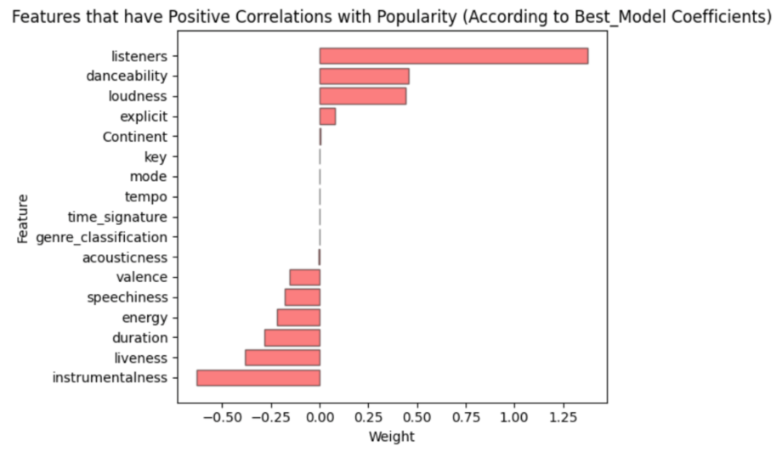
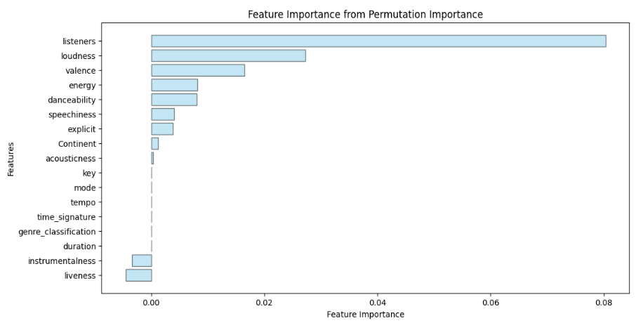
Feature Importance Analysis
Top Features (Permutation Importance)
Listeners (0.0803)
Key Insights
Loudness (0.0273)
Audience engagement is crucial
Valence (0.0165)
Dynamic, positive tracks perform well
Danceability (0.0081)
Instrumentalness and liveness have negative correlation
Energy (0.0082)

Slide 8
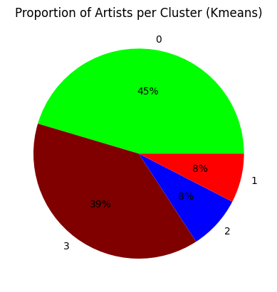
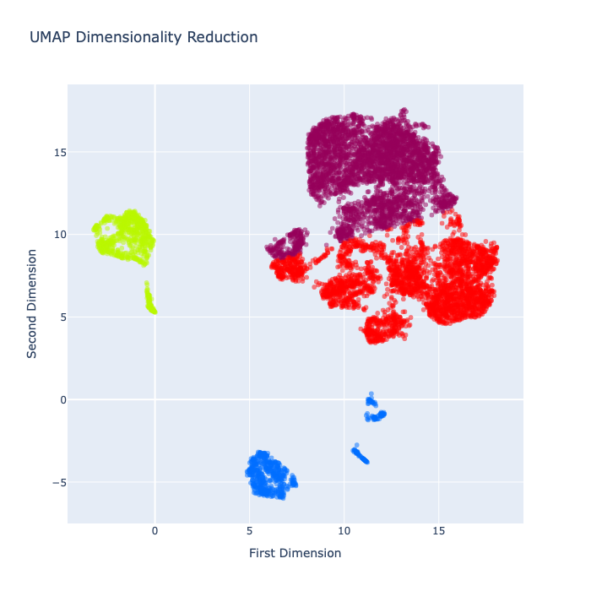
Cluster 0
Cluster 2
Cluster 3
Clustering Results (K-means)
Cluster 1
4 Distinct Clusters Identified
Cluster 2: Mainstream Hits
Optimal number determined by Elbow Method
Highest popularity (76.88) and listeners (1.03 million)
Clusters 0 & 3: Mid-Tier Tracks
Cluster 1: Experimental/Niche
Moderate popularity, serving niche audiences
Lowest popularity, higher speechiness and liveness

Slide 9
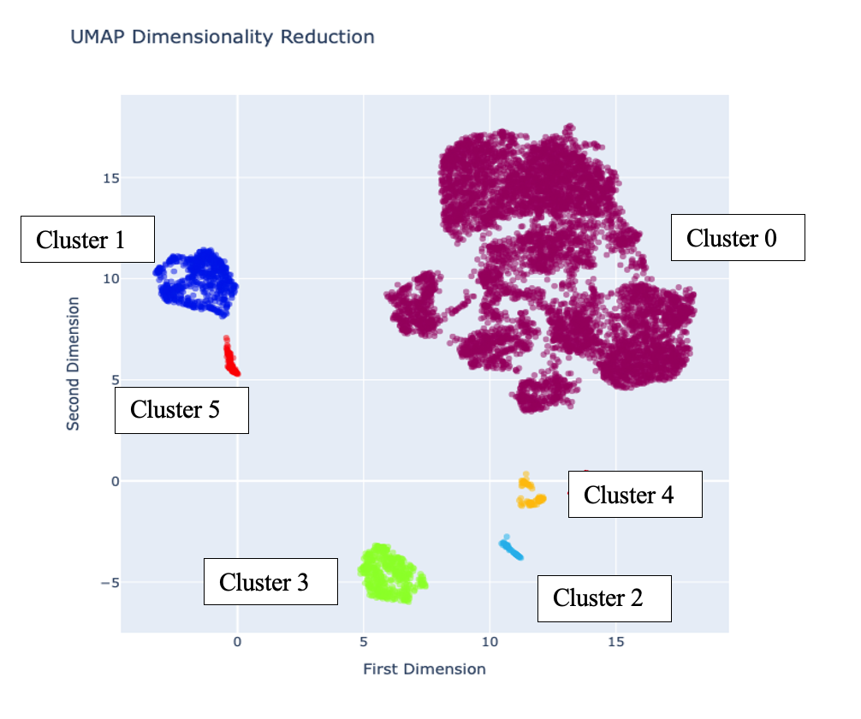
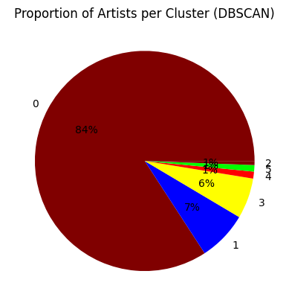
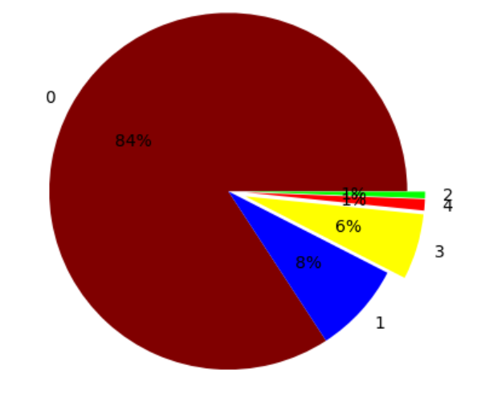
Clustering Results (DBSCAN)
6 Dense Clusters
Cluster 5: Mainstream Success
Noise points represent potential emerging trends
Highest popularity (78.28) and listeners (1.2 million)
Cluster 0: Moderately Popular
Clusters 3 & 4: Niche Genres
Largest cluster with 6,920 tracks
Lower popularity, unique audio characteristics

Slide 10
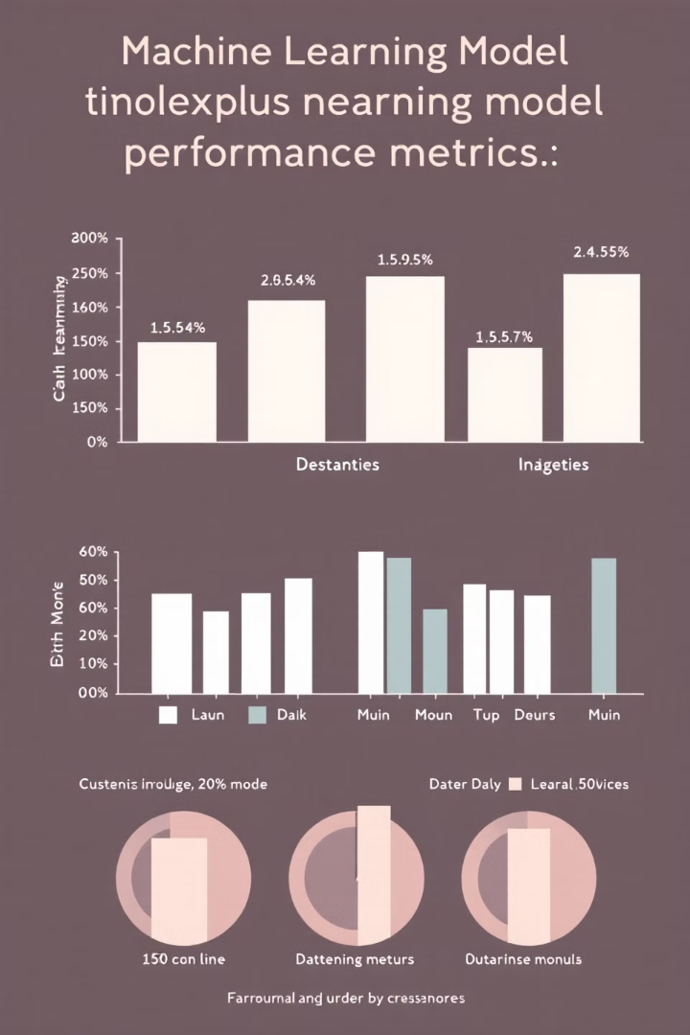
Predictive Model Performance
Model
Accuracy
Recall
Precision
F1 Score
ROC-AUC
Random Forest
90.88%
51.63%
50.97%
51.30%
73.27%
SVC
85.71%
71.90%
36.42%
48.35%
79.51%
Logistic Regression
85.00%
75.00%
36.00%
49.00%
81.00%

Slide 11

ROI Analysis
€2.69M
€2,000
Net Savings
Promotion Cost
Using predictive model vs. promoting all tracks
Assumed cost per track for marketing
€0.00437
100K
Stream Revenue
Popular Track Plays
Average payout per stream on Spotify
Average streams for a successful track

Slide 12




Recommendations for Artists
Focus on Listener Engagement
Optimize Track Features
Collaborate Strategically
Prioritize growing and retaining audience
Balance energy, danceability, and valence
Use clustering insights to find complementary artists

Slide 13

Recommendations for Investors
Use Predictive Models
Target Popular Clusters
Use machine learning to discover tracks and artists with great potential
Cluster 2(K-Means), Cluster 5(DBSCAN): Concentrate resources on users in these clusters.
Diversify Portfolio
Monitor ROI Closely
The mix of mainstream and emerging genre investments
Optimize promotional spend through cost-benefit analysis

Slide 14





Recommendations for Platforms
Refine Recommendation Algorithms
Use clustering analysis to create customized playlists
Support Emerging Trends
Promote the “noise” tracks to find new genres
Provide Artist Analytics
Provide artists with data-driven insights to help succeed
Optimize User Experience
Employ predictive algorithms for content recommendation

Slide 15
Limitations and Future Work
Limitations
Future Directions
Reliance on public datasets
New real-time streaming data
Emphasis on quantitative metrics
Review trends across different streaming platforms
Possible platform bias
Apply qualitative factors (lyrics, culture)
Build sustainable AI practices and principles

Slide 16




Conclusion
Audience Engagement is Key
1
Listeners are the best predictor of popularity
Market Segmentation Insights
2
Mainstream and niche opportunities revealed by clustering
Predictive Models Drive ROI
3
Machine learning fine-tunes how promotions are managed
Holistic Approach Needed
4
Merge creativity with data-driven decision making

Slide 17

Code Explanation
Emphasizing Data Cleaning, EDA, and Processing

Slide 18
Overview of Data Sources
The Spotify Tracks Dataset
The Music Artists Popularity Dataset
Gives music features of the song such as danceability, loudness, and tempo
Provides usage data such as scrobbles, listeners, and tags.
There were missing values, duplicates, as well as inconsistent columns having different formats to reconcile.

Slide 19
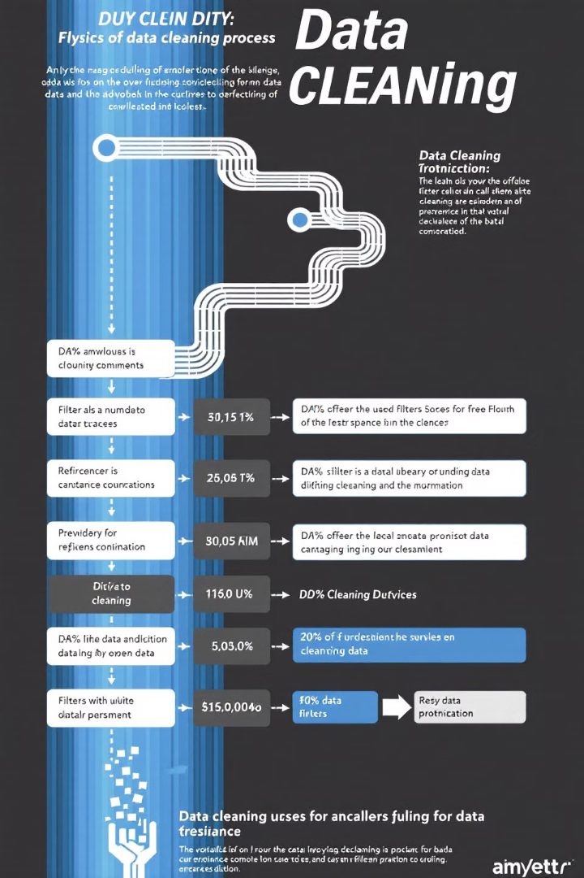
Data Cleaning Process
1
Remove Critical Missing Values
Dropped rows with nulls in important columns
2
Drop Duplicate Records
Remove rows where the artists name is duplicated,
ensuring only get the best row for each artist (highest listeners)
3
Filter Artist Collaborations
Excluded entries with ';' in artist names for consistency.
df2 = df2_temp.drop_duplicates(subset='artists', keep='first')
df.dropna(inplace=True) df = df[~df['artists'].str.contains(';')]

Slide 20




Data Transformation
Genre Classification
Summarized main 12 genres from original 113 genres
Geographical Encoding
Mapped countries to continents to gain larger regional perspective.
Feature Engineering
Formed binary popularity labels & changed duration to minutes.
df12_new['duration'] = df12_new['duration_ms'] / 60000
df12_new.drop(columns=['duration_ms'], inplace=True)
df12_new['is_popular'] = df12_new['popularity'].apply(lambda x: 1 if x > 70 else 0)

Slide 21
Data Integration
Merge Datasets
1
Merged Music Artists Popularity and Spotify Tracks Datasets by using the 'artists' column.
Resolve Inconsistencies
2
Identified inconsistencies in unique identifiers across datasets.
Verify Integration
3
Merging as per the requirements with data validation checks.
df12 = df1.merge(df2, how='inner', on='artists')

Slide 22
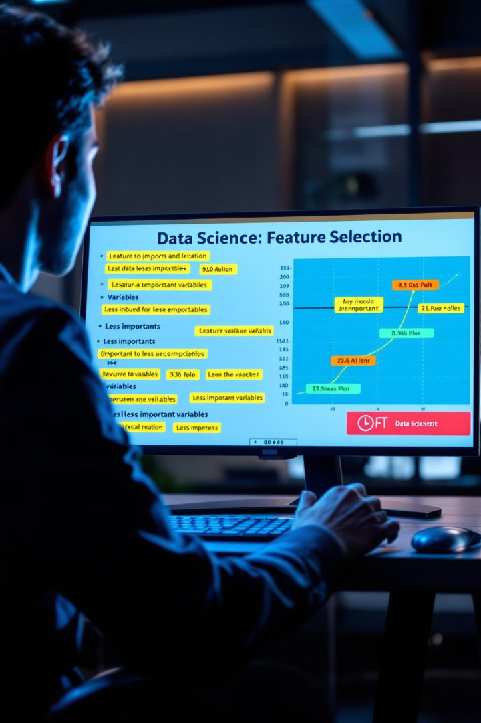



Feature Selection
Drop Irrelevant Columns
Encode Categorical Variables
Only took the numerical features and removed the track and album names
Make the genres and continents label encoded to fit the model.
Select Key Features
Selected features best suited to predicting song popularity

Slide 23
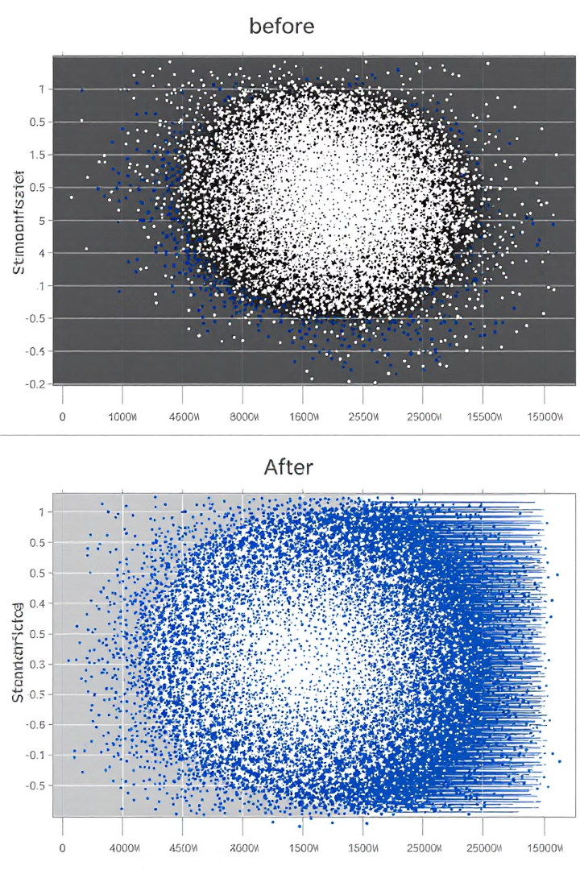
Data Standardization
Purpose
Method
Scale down data between 0 and 1 to be able to better compare models against one another.
Used StandardScaler for numerical columns for Scaling values between 0 to 1.
Implementation
sklearn with StandardScaler to transform the dataset.
from sklearn.preprocessing import StandardScaler
scaler = StandardScaler()
X_train = scaler.fit_transform(X_train)
X_test = scaler.transform(X_test)

Slide 24

SMOTE: Balancing Class Distribution
Purpose
Method
Implementation
Efficiently balances the distribution of classes using synthetic samples of the minority class.
imblearn library in Python to implement SMOTE.
from imblearn.over_sampling import SMOTE
smote = SMOTE(random_state=42)
X_train, y_train = smote.fit_resample(X_train, y_train)

Slide 25




Clustering Analysis Insights
K-means Clustering
DBSCAN Analysis
Clustering of tracks based on audio features.
Elbow method was used to unveil the natural clusters within the Spotify dataset.
Density-Based Spatial Clustering of applications with Noise
Identify niche trends and data outliers to uncover unique market segments.
Key Findings
Find mainstream hits, experimental tracks and niche genres. These insights help in marketing and content creation.

Slide 26
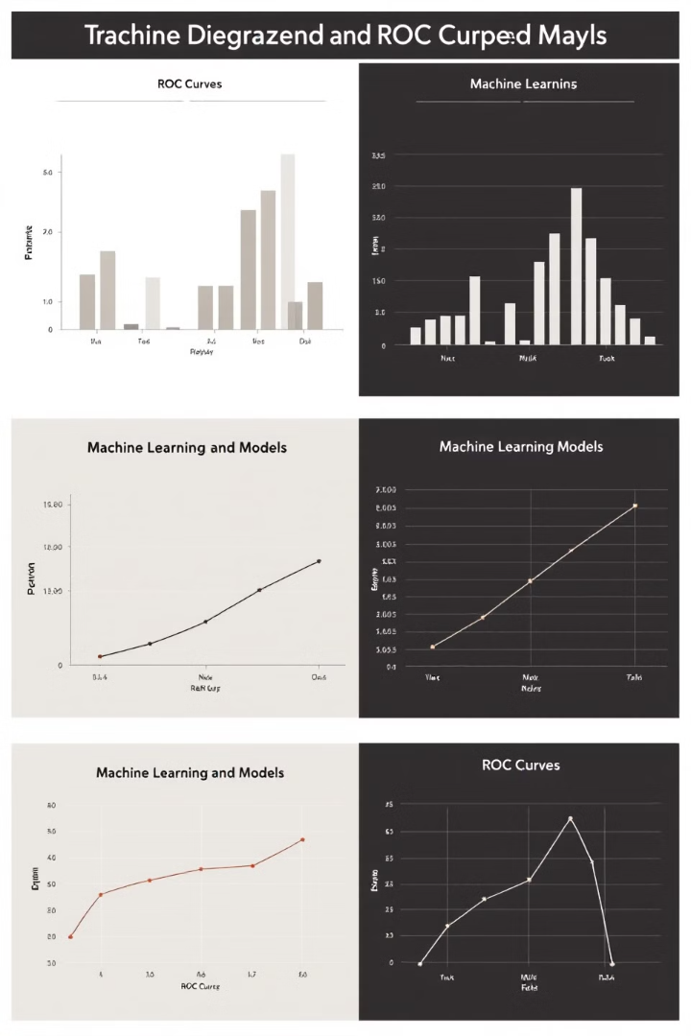
Model Evaluation Results
Model
Accuracy
F1 Score
ROC-AUC
Random Forest
90.88%
51.30%
73.27%
SVM
85.71%
48.35%
79.51%
Logistic Regression
85.00%
49.00%
81.00%
Random Forest outperformed among the classifiers
ROC-AUC was observed to be the highest in Logistic Regression.
Need to take into account multiple metrics beyond accuracy when evaluating models for predicting music popularity.

Slide 27
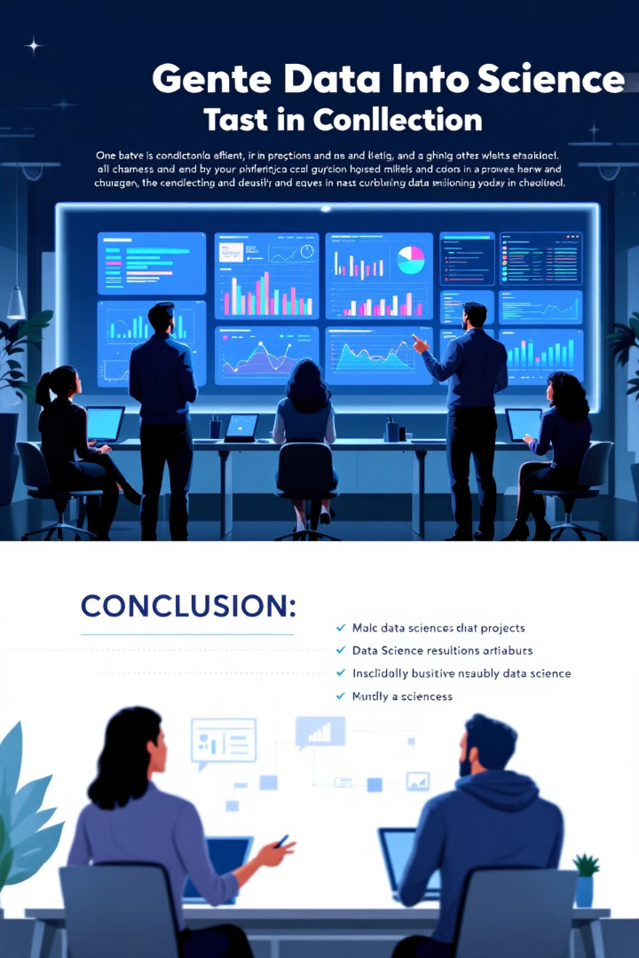
Conclusion
1
Improved Data Quality
2
Insightful EDA
Exploratory analysis was conducted to identify important feature relationships and trends.
Dataset reliability was improved through cleaning and engineering.
3
Model-Ready Data
Preprocessed dataset filtered for different types of machine learning

Slide 28




Future Directions
Incorporate Additional Sources
Combine YouTube metrics for deeper insights.
Advanced Feature Engineering
Try out complex feature interactions and transformations.
Time-Series Analysis
By date: Investigate temporal trends in music popularity and listener behavior.

Slide 29



Aguilar, L. and Waldfogel, J., 2015. Streaming reaches flood stage: does spotify stimulate or depress music sales. NBER Working Paper Series, October, 4, p.20.
Brennan, M., 2020. The environmental sustainability of the music industries. Cultural Industries and the Environmental Crisis: New Approaches for Policy, pp.37-49.
Datta, H., Knox, G. and Bronnenberg, B.J., 2018. Changing their tune: How consumers’ adoption of online streaming affects music consumption and discovery. Marketing Science, 37(1), pp.5-21.
Herremans, D. and Bergmans, T., 2020. Hit song prediction based on early adopter data and audio features. arXiv preprint arXiv:2010.09489.
Kowald, D., Lex, E. and Schedl, M., 2020. Utilizing human memory processes to model genre preferences for personalized music recommendations. arXiv preprint arXiv:2003.10699.
Khan, F., Tarimer, I., Alwageed, H.S., Karadağ, B.C., Fayaz, M., Abdusalomov, A.B. and Cho, Y.I., 2022. Effect of feature selection on the accuracy of music popularity classification using machine learning algorithms. Electronics, 11(21), p.3518.
Kaggle. (2022). **Spotify Tracks Dataset**. Retrieved from [https://www.kaggle.com/datasets/maharshipandya/-spotify-tracks-dataset](https://www.kaggle.com/datasets/maharshipandya/-spotify-tracks-dataset)
Kaggle. (2022). **Music Artists Popularity Dataset**. Retrieved from [https://www.kaggle.com/datasets/pieca111/music-artists popularity/data](https://www.kaggle.com/datasets/pieca111/music-artists-popularity/data)

Slide 30



Q&A
Open Discussion
Addressing Concerns
Future Collaborations

Slide 31

Thank You!
Much appreciate for your listening and feedbacks

